Slide 2
Data Description

Slide 3
Data Exploration and Missing Data Handling

Slide 4
Feature Engineering:
Feature Transformation

Slide 5
Feature Engineering:
Feature Generation
PerPassengerFare
PayNoFare

Slide 6
Feature Engineering
To Evaluate the feature importance, we have adopted the following two approaches to rank the features,
RandomForest
Boruta

Slide 7
Feature Engineering
RandomForest (top 6)
Pclass
Title
PerPassengerFare
Sex
AgeGroup
Cabin

Slide 8
Feature Engineering
Boruta (top 6)
Set
Pclass
Title
PerPassengerFare
SocialClass
FamilySize

Slide 9
Model Training, Prediction and Evaluation -Naïve Bayes Classification
Features
All 10 features
Training
Training 2/3 and Test 1/3, roughly
Train_Train <- Train_Data[1:599,]
Train_Test <- Train_Data[600:891,]
Model trained with Laplace smoothing
survival_classifier <- naiveBayes(Train_Train, Train_Train$Survived, laplace = 1)

Slide 10
Model Training, Prediction and Evaluation -Naïve Bayes Classification
Prediction and Evaluation
100%
Predicted | Actual
 | 0 | 1 | Row Total
0 | 185 | 0 | 185
1 | 0 | 107 | 107
Column Total | 185 | 107 | 292

Slide 11
Model Training, Prediction and Evaluation -Neural Network
Features
All 10 features
Training
Training 2/3 and Test 1/3, roughly
Train_Train <- Train_Data[1:599,]
Train_Test <- Train_Data[600:891,]
NN Model
Default: survival_NNet1 <- neuralnet(Survived ~ ., data = Train_Train)
Improved: survival_NNet1 <- neuralnet(Survived ~ ., data = Train_Train, hidden=5, stepmax=1e6)

Slide 12
Model Training, Prediction and Evaluation -Neural Network
Prediction and Evaluation
83.22%
Predicted | Actual
 | 0 | 1 | Row Total
0 | 163 | 27 | 190
1 | 22 | 80 | 102
Column Total | 185 | 107 | 292

Slide 13
Problem Statement & Data Description
Variable | Definition | Key
survival | Survival | 0 = No, 1 = Yes
pclass | Ticket class | 1 = 1st, 2 = 2nd, 3 = 3rd
sex | Sex
Age | Age in years
sibsp | # of siblings / spouses aboard the Titanic
parch | # of parents / children aboard the Titanic
ticket | Ticket number
fare | Passenger fare
cabin | Cabin number
embarked | Port of Embarkation | C = Cherbourg, Q = Queenstown, S = Southampton

Slide 14
Problem Statement & Data Description
PassengerId Survived Pclass Name Sex Age SibSp
Mode :logical Mode :logical Mode :logical Mode :logical Mode :logical Mode :logical Mode :logical
FALSE:891 FALSE:891 FALSE:891 FALSE:891 FALSE:891 FALSE:714 FALSE:891
TRUE :177
Parch Ticket Fare Cabin Embarked
Mode :logical Mode :logical Mode :logical Mode :logical Mode :logical
FALSE:891 FALSE:891 FALSE:891 FALSE:204 FALSE:889
TRUE :687 TRUE :2

Slide 15
Problem Statement & Data Description
> str(Train)
'data.frame': 891 obs. of 12 variables:
$ PassengerId: int 1 2 3 4 5 6 7 8 9 10 ...
$ Survived : int 0 1 1 1 0 0 0 0 1 1 ...
$ Pclass : int 3 1 3 1 3 3 1 3 3 2 ...
$ Name : chr "Braund, Mr. Owen Harris" "Cumings, Mrs. John Bradley (Florence Briggs Thayer)" "Heikkinen, Miss. Laina" "Futrelle, Mrs. Jacques Heath (Lily May Peel)" ...
$ Sex : chr "male" "female" "female" "female" ...
$ Age : num 22 38 26 35 35 NA 54 2 27 14 ...
$ SibSp : int 1 1 0 1 0 0 0 3 0 1 ...
$ Parch : int 0 0 0 0 0 0 0 1 2 0 ...
$ Ticket : chr "A/5 21171" "PC 17599" "STON/O2. 3101282" "113803" ...
$ Fare : num 7.25 71.28 7.92 53.1 8.05 ...
$ Cabin : chr NA "C85" NA "C123" ...
$ Embarked : chr "S" "C" "S" "S" ...

Slide 16
Missing data handling: Cabin & Age & Fare & Embarkation
Cabin missing in both Train & Test
Strip the numbers and keep the Leading Letter
Completely drop the cabin feature
Age missing in both Train & Test
Fill up
Fare only 1 out of 418 record missing in Test
Is this feature useful
Fill it based on the mean per passenger fare by Pclass
Embarked only 2 records out of 891 missing in Train
Only 2 missing, we could simply drop the two records

Slide 17
Dropping Cabin feature
Based on Wiki Titanic Deck Plan
Strong correlation between Pclass and Deck/Cabin
Large percentage of missing
More noise could be introduced trying to fill the missing Cabin

Slide 18
Dropping Cabin feature
A Deck, It was reserved exclusively for First Class passengers and contained First Class cabins…
B Deck, More First Class passenger accommodations were located here with six cabins.
C Deck, the Shelter Deck, was the highest deck to run uninterrupted from stem to stern. Crew cabins were housed below the forecastle and Third Class public rooms were housed below the Poop Deck. In between were the majority of First Class cabins and the Second Class library.^{[27][29]}
D Deck, Second and Third Class passengers had cabins on this deck,
E Deck, the Upper Deck, was predominantly used for passenger accommodation for all three classes plus berths for cooks, seamen, stewards…
F Deck, the Middle Deck, mainly accommodated Second and Third Class passengers and several departments of the crew.
G Deck, the Lower Deck, was the lowest complete deck that carried passengers, just above the waterline.
The Orlop Decks and the Tank Top below that were on the lowest level of the ship, below the waterline.

Slide 19
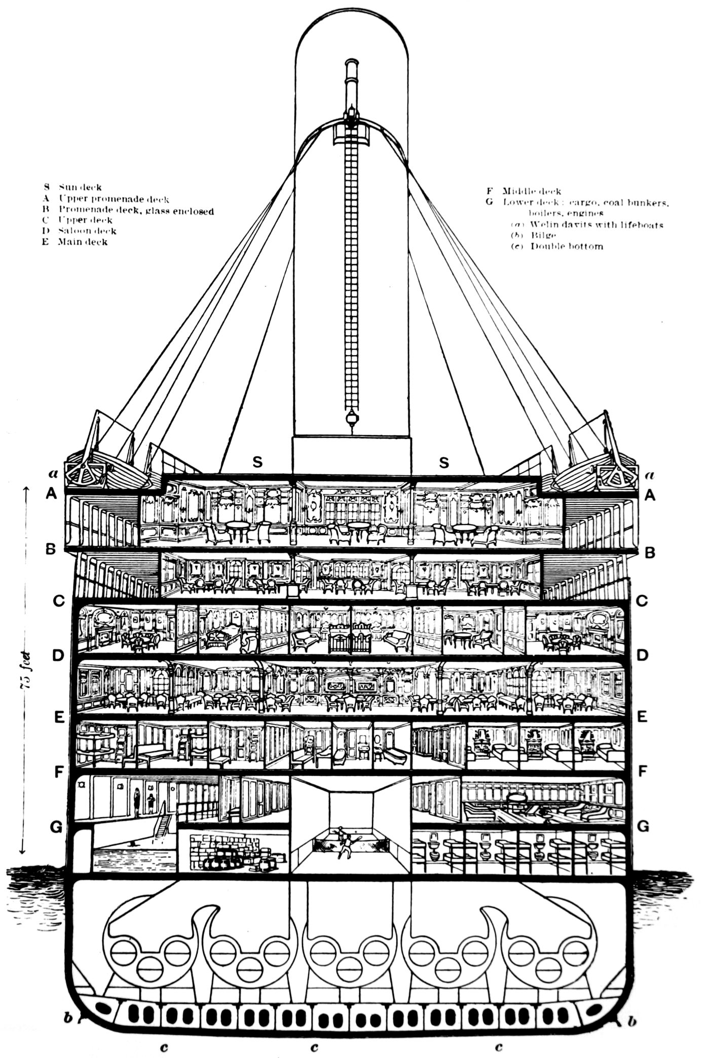
Dropping Cabin feature

Slide 20
Fill missing data:Age
Approach 1: Using MICE
Approach 2: Linear regression with top 5 most correlated features
R-Squared is about 40%, less than desirable
Plus there are negative Age value predicted
Not very confident in this model and eventually giving up the model
Approach 3: fill.na using Median Value
Categorize

Slide 21
Fill missing data: Fare in Test
Age > 60, Pclass = 3, doesn’t fit into the Crew Labor, thus fill the Fare value from the Mean of Pclass 3 per passenger fare

Slide 22
Fill Missing data: Embarked
Doesn’t profit much from digging into it as only 2 of 891 missing
Use the most frequent value in all non NA records

Slide 23
Feature Generation
Social status by Title
Pclass is more on Economic status
New FamilySize feature
Combining sib and parch
Need prove strong correlation among these two
Per Passenger Fare
Fare/FamilySize (note family size = sib + parch Ming Xiu proposed above)
Any strong correlation between Per Passenger Fare and Pclass?
Paying No Fare
Is VIP, Engineer, Crew and all those who worked on the ship, based on Fare, those paying no fare are likely to fall under this category
Why it’s important? They know the ship better, they are more likely to help passengers which might impact their own chance of survival.

Slide 24
Data exploration/Feature importance: intuitive approach
Ming Xiu’s Plots on
Gender
Age
Social Status
Economic Status
Family Size
Deck/Cabin
etc

Slide 25
Data Exploration/Feature importance: non-intuitive approach
Random forest to get Gini index for feature importance
Any other feature importance model to run
The output will be the feature importance ranking from 1~11

Slide 26
Modeling and Comparison
Split the train set 891 into train & test (2/3, 1/3)
For each model/algo that we want to run
Run it with Gini index top 2 features
Run it with Gini index top 3 features
Run it with Gini index top 4 features
Run it with Gini index top 5 features
Run it with Gini index top 6 features
……………………………………10……………
For each model/algo, with each addition of feature
Compare with the best accuracy rate
Identify the winner
Of all the models/algos, the one with highest accuracy will be the one we submit to Kaggle
Note we need to include this Kaggle Score in our report.

